Slide 1
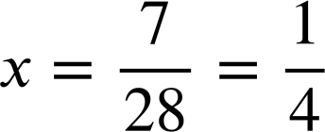
Problem solving with linear equations
Task A: Solving geometric problems
1) The perimeter of this rectangle is 7. Work out the value of x
6x − 1
2(6x − 1) + 2(8x + 1) | = | 7
12x − 2 + 16x + 2 | = | 7
28x | = | 7
8x + 1
2) Find the perimeter of this equilateral triangle.
An equilateral triangle has equal lengths.
5x + 20
8x − 7
5x + 20 | = | 8x − 7
20 | = | 3x − 7
27 | = | 3x
x | = | 9
5x + 20 = 5(9) + 20 = 45 + 20 = 65
The perimeter is 3 × 65 = 195
3) Two identical rectangles make this compound shape with perimeter 48. Work out the value of x
5x − 6
(6x − 2) − (x + 4)
= 6x − 2 − x − 4
6x − 2
6x − 2
= 5x − 6
x + 4
3(6x − 2) + 3(5x − 6) + (x + 4) = 48
18x − 6 + 15x − 18 + x + 4 = 48
5x − 6
5x − 6
34x − 20 = 48
34x = 68
6x − 2
x = 2
4) The rectangle and the square have equal perimeters. Work out this perimeter.
8 − x
6x − 5
5x + 2
2(8 − x) + 2(5x + 2) | = | 4(6x − 5)
16 − 2x + 10x + 4 | = | 24x − 20
8x + 20 | = | 24x − 20
40 | = | 16x
x | = | 2.5
6x − 5 = 6(2.5) − 5 = 10
4 × 10 = 40
The perimeter of both shapes is 40

Slide 2
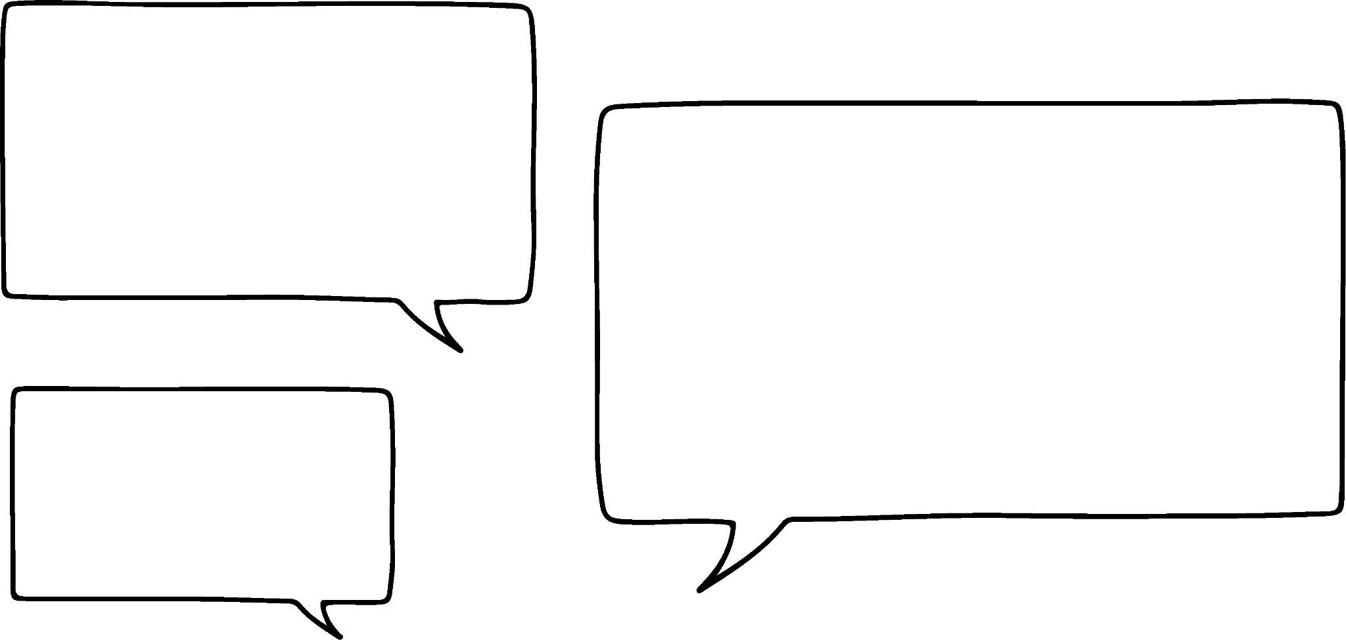

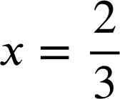





Problem solving with linear equations
Task B: Forming and solving equations from worded problems
1) a) An electrician has a call out fee and then charges £45 per hour. For an eight hour job they charge £385. Form an equation and calculate their call out fee.
c + 8 × £45 = £385
c + £360 = £385
c = £25
Their call out fee is £25
b) Another electrician has a call out fee of £50 and for an eight hour job they charge £370
Form an equation to calculate their hourly rate.
£50 + 8x = £370
8x = £320
x = £40
2) Andeep has made two number problems.
Write an equation and find the number in each case.
Their hourly rate is £40
a) I have a number whereby if you multiply it by 3 and add 60 it’s the same as if you multiply it by 7 and minus 8
3x + 60 = 7x − 8
3x + 68 = 7x
Andeep’s number is 17
68 = 4x
x = 17
5x − 7 = 2x − 5
b) I have another number whereby if you multiply it by 5 and minus 7 it’s the same as if you multiply it by 2 and minus 5
3x − 7 = −5
3x = 2
Andeep’s number is
3) Jun, Aisha and Jacob are buying a present for classmates.
a) Aisha spends £2 more than Jun and Jacob spends three times as much as Jun. In total they spend £39.50 How much does Jacob spend?
Jun
x
5x + 2 = 39.50
Aisha
x
2
£39.50
5x = 37.50
x
x
x
x = 7.50
Jacob
Jacob spends 3 × £7.50 = £22.50
b) Aisha spends £5 more than Jun and Jacob spends four times as much as Aisha. Jacob spends £33 more than Aisha. How much does Jun spend?
Jun
x
3(x + 5) = 33
Aisha
x
5
£33
x + 5 = 11
x
5
x
5
x
5
x
5
x = 6
Jacob
Jun spends £6
Mathematics in Education and Industry.
v2.3

